Slide 1
Checking understanding of pictograms and bar charts
Graphical representations of data

Slide 2
how to use Oak lessons

Slide 3
I can interpret both pictograms and bar charts.

Slide 4
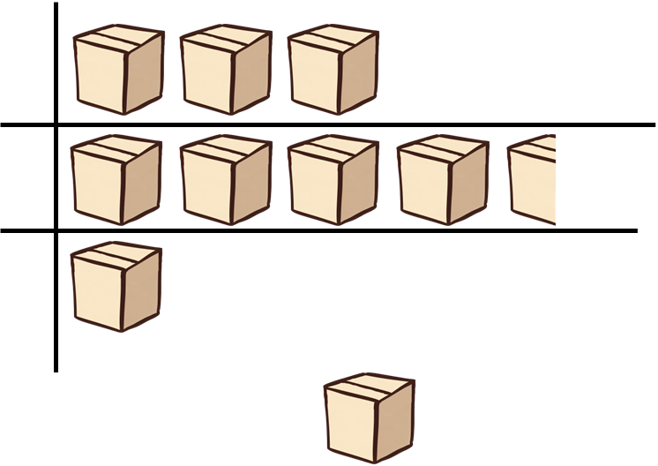
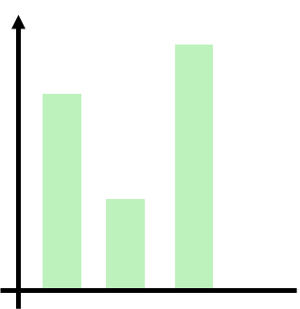
Data are a set of information which shows counts or measurements. (Singular datum.)
A key is used to explain the meaning of the symbols used in a table, chart, graph or a map.
categories
A pictogram (pictograph) is a graph consisting of pictures to visually represent the frequency of objects or groups.
= 5 boxes
A bar chart (bar graph) is a graph consisting of bars visually representing the frequency of objects or groups.
frequency
categories

Slide 5
The frequency is the number of times an event occurs; or the number of individuals (people, animals etc.) with some specific property.

Slide 6

Checking understanding of pictograms and bar charts
Pictograms
Bar charts

Slide 7
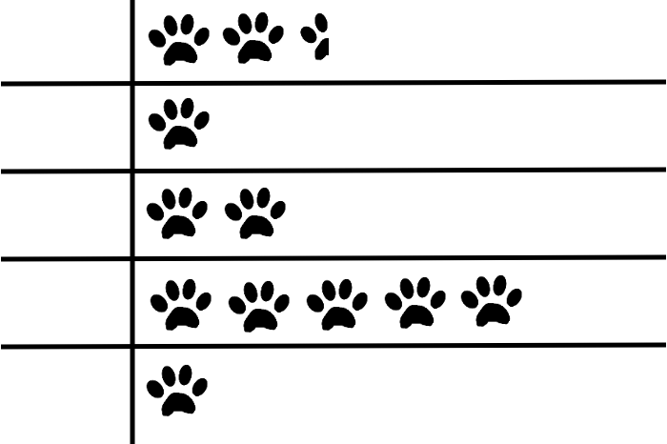


Pictograms
Jacob would like to know which pet is most common in his class.
He collects some data from his class and draws a pictogram.
dog
What information does my pictogram show?
hamster
fish
cat
rabbit

Slide 8
Pictograms
the most common pet is cat
the frequency of hamsters and rabbits is the same
there are the same number of fish as hamsters and rabbits combined
there are half as many dogs as cats
dog
hamster
fish
cat
rabbit

Slide 9

Pictograms
dog
This pictogram cannot be correct.
It says there are 2.5 dogs.
hamster
fish
cat
rabbit
Sam
There are 2.5 icons but an icon does not have to represent 1 animal. So Sam is wrong; the pictogram could be correct, but it is missing a key!
Is Sam correct?

Slide 10


Pictograms
Laura
dog
I think one paw means 4.
hamster
Sam
fish
I think one paw means 10.
cat
rabbit
Lucas
I think one paw means 5.
Who cannot be correct?
It cannot be 5 per paw, or dogs would be 12.5 pets.

Slide 11

Pictograms
dog
4
4
2
Pet | Frequency
dog
hamster
fish
cat
rabbit
hamster
4
10
4
fish
4
4
8
cat
4
4
4
4
4
20
rabbit
4
4
Key
= 4 pets

Slide 12

Pictograms
Jacob has collected some more data about pets. He has represented it as a pictogram. Complete the frequency table.
dog
Pet | Frequency
Dog
Hamster | 10
Fish | 20
Cat
Rabbit | 15
hamster
25
fish
cat
50
rabbit
Key
= 10 pets

Slide 13

Pictograms
Pictograms are a very visual representation of data.
Number of books in each genre
Horror
Romance
Sci-fi
Detective
Key = 10 books
Fairly easy to understand and get a feel for the data.

Slide 14






Pictograms
A pictogram is going to be constructed for the total rainfall in four places around the UK in Apr 2010.
I would use an umbrella icon.
I would use a welly boot.
I would use rain droplets.
Jun
Sofia
Izzy
All of these choices would be representative of the data. Is one better than the others?
The boot would be difficult to divide up.
The umbrella would struggle to fit most data.
The rain droplet can be grouped and fit more data.

Slide 15
Pictograms
Pictograms are a very visual representation of data.
Total amount of rainfall (nearest mm) in April 2010
Armagh
Camborne
Lerwick
Lowestoft
Key = 6 mm of rain
However sometimes it can be hard to find a good icon and value to fit the data.

Slide 16

Pictograms
Which of the following sets of data could most easily be shown as a pictogram?
Colour | Frequency
Red | 12
Green | 39
Blue | 23
Colour | Frequency
Red | 210
Green | 190
Blue | 260
Colour | Frequency
Red | 9
Green | 183
Blue | 251
They are large but all multiples of 10.

Slide 17
Pictograms
What are the characteristics of a good pictogram? Choose all that apply.
Simple representative icons
Uneven spacing between icons
Key with the value of the icon

Slide 18


Pictograms
Complete the statements regarding the pictogram.
Most people play
Cricket
Golf
is the least played sport
Rugby
Twice as many people play hockey as
Football
Hockey
The same number of people play football as and combined.

Slide 19

Pictograms
Complete the pictogram.
Jun has 6 more cogs than Izzy.
Jun
Izzy
= 3 cogs

Slide 20
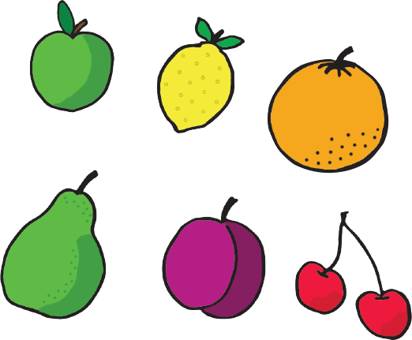
Pictograms
Add the key to this pictogram.
There is a total of 280 apples.
Week 1
Key
=
Week 2
Week 3

Slide 21
Pictograms
Complete the statements regarding the pictogram.
Most people play
football
Cricket
Golf
Golf
is the least played sport
Rugby
Twice as many people play hockey than
Football
rugby
Hockey
The same number of people play football as and combined.
hockey
rugby

Slide 22
Pictograms
Complete the pictogram.
Jun has 6 more cogs than Izzy.
Jun
Izzy
= 3 cogs

Slide 23
Pictograms
Add the key to this pictogram.
There is a total of 280 apples.
Week 1
Key
=
20 apples
Week 2
Week 3

Slide 24
Checking understanding of pictograms and bar charts
Pictograms
Bar charts

Slide 25
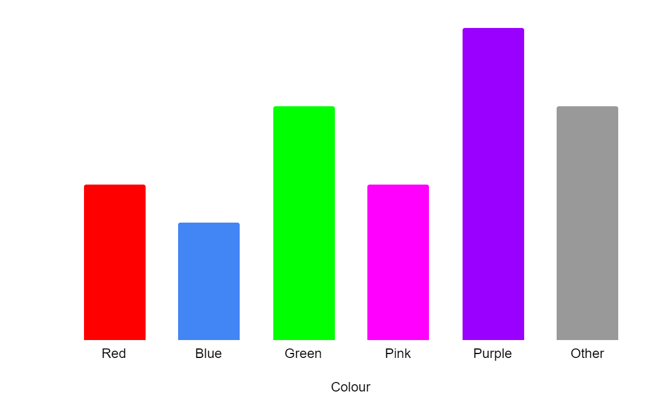
Bar charts
Laura is designing a new marketing campaign.
She has collected data regarding people’s favourite colours.
What is missing from Laura’s bar chart?
Vertical axis

Slide 26
Bar charts
Laura made a note of the frequencies.
Can you match the frequency to the correct bar and colour?
I know the frequencies should be:
10, 12, 12, 16, 16, 22
but I can’t remember which one goes with which bar.
22
16
16
12
10
12

Slide 27
Bar charts
Frequency is shown on a bar chart by:
the height of the bars
You need a scale on the frequency axis (often the vertical axis but not always) and the height of bars to fully represent the frequencies on a bar chart.
the labels of the bars
the vertical axis scale

Slide 28
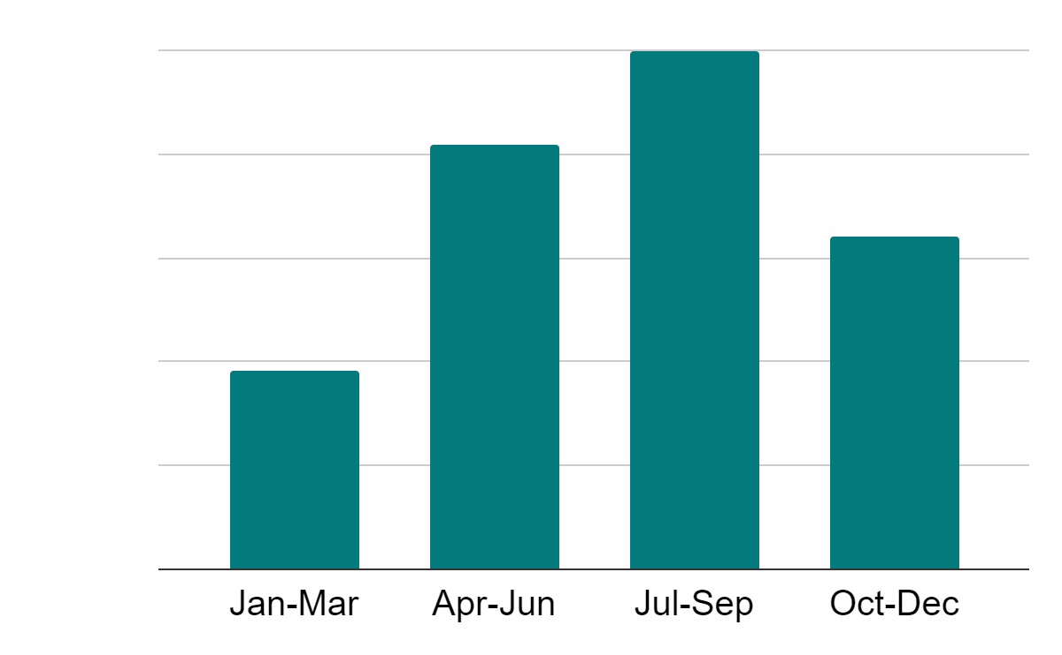
Bar charts
Without the axis or frequency you cannot read this bar chart.
Bar chart to show number of trips abroad by UK residents
Sofia
We can comment on the most or least popular times for travel.
When do UK residents travel abroad the most?
Sam
July to September, can you think why that might be?

Slide 29
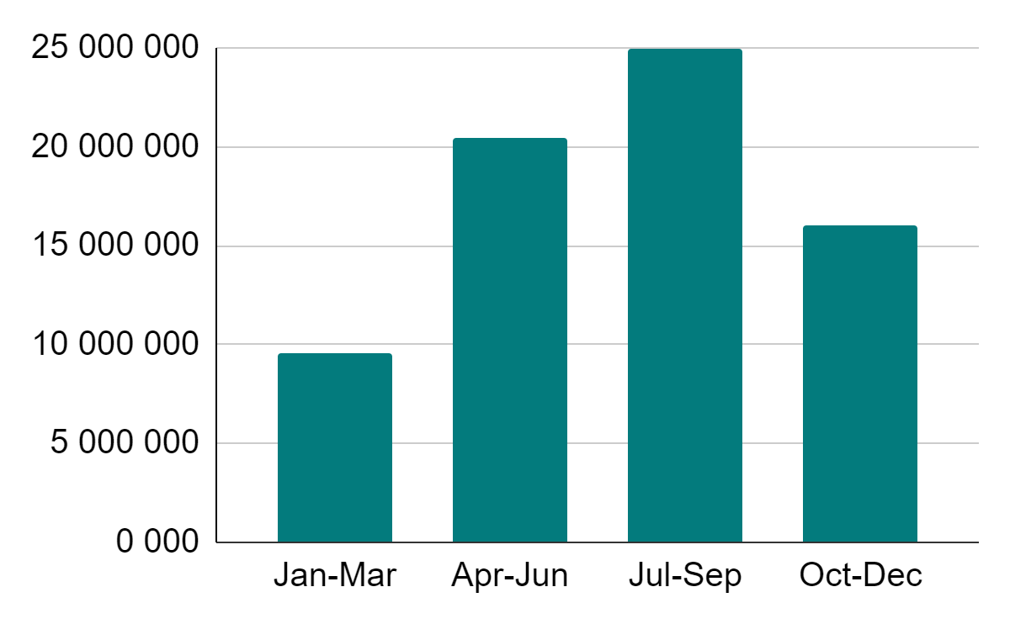
Bar charts
Bar chart to show number of trips abroad by UK residents per quarter.
Approximately how many residents travelled abroad during the months of July to September?
About 25 million
Frequency
We might like to consider why UK residents travel abroad - can you think of any reasons?
You may have thought of:
holidays
visiting family or friends
work/business
Months

Slide 30
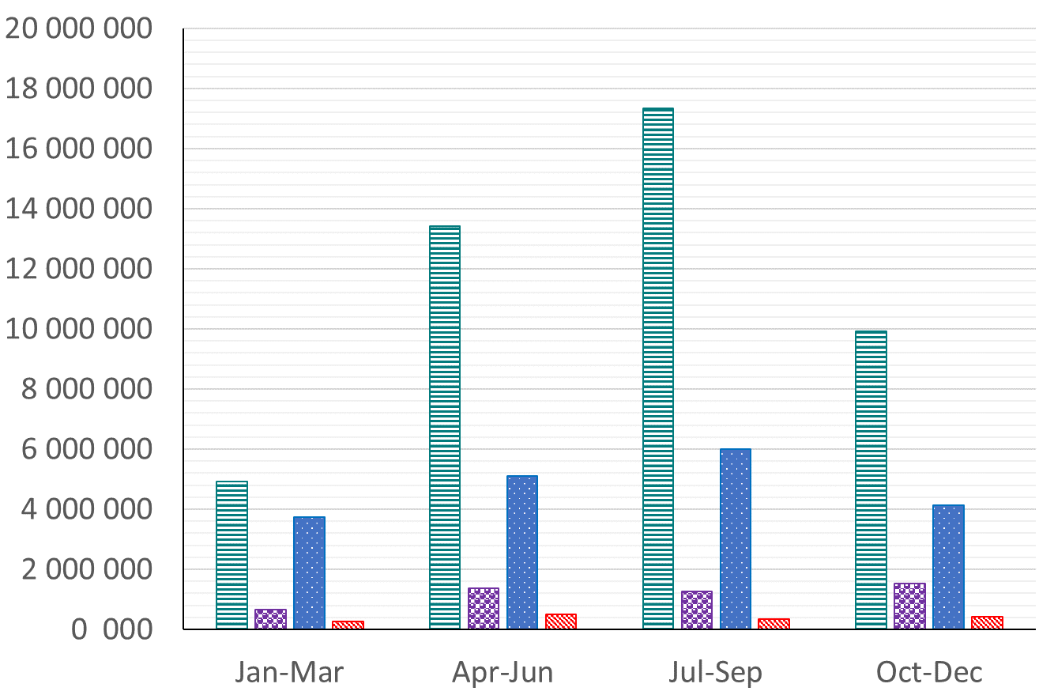
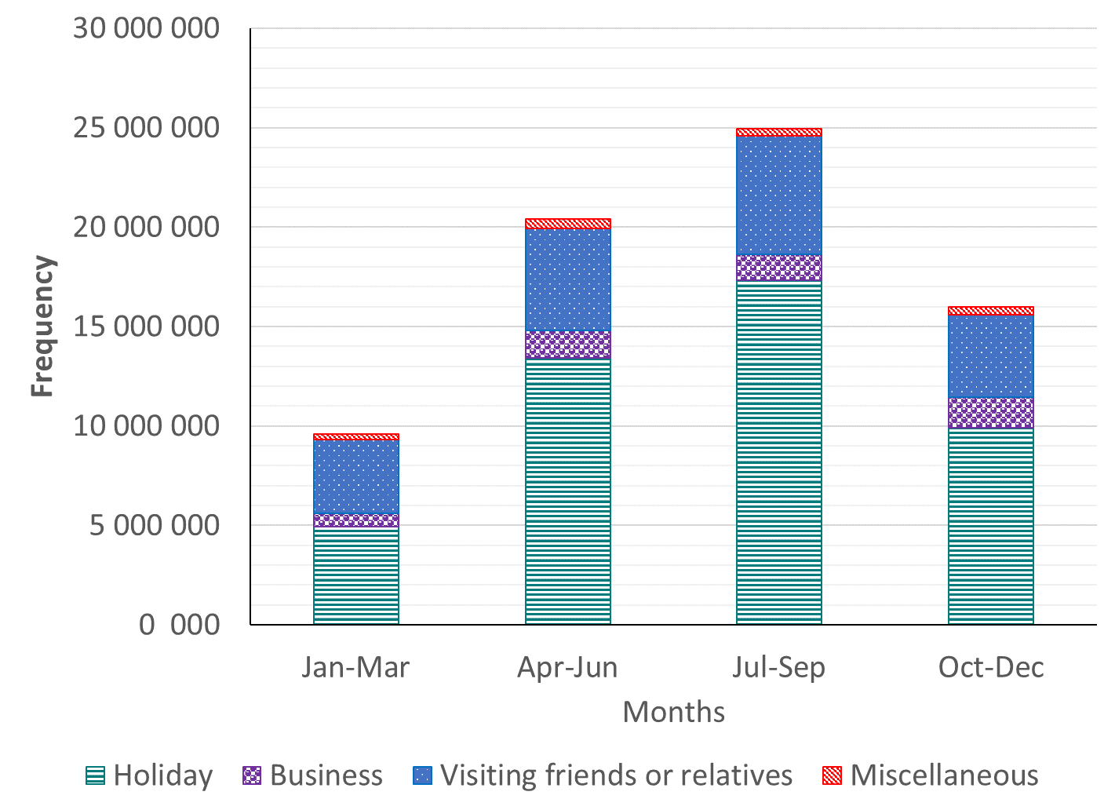
Bar charts
Bar charts to show number of trips abroad by UK residents
Holiday
Holiday
Business
Business
Visiting
Visiting
Frequency
Frequency
Other
Other
Months
Months
This is a comparison bar chart.
This is a stacked bar chart.
Comment on the two bar charts. Consider what is the same and what is different between them?

Slide 31
Bar charts
Comment on the two bar charts. Consider what is the same and what is different between them.
They both show total trips abroad and the breakdown by reason.
The comparison bar chart is easier to analyse the reasons for travel within each period of time.
The stacked bar chart allows you to easily see which months were the most popular, whereas the comparison bar chart requires some calculations to be sure.

Slide 32
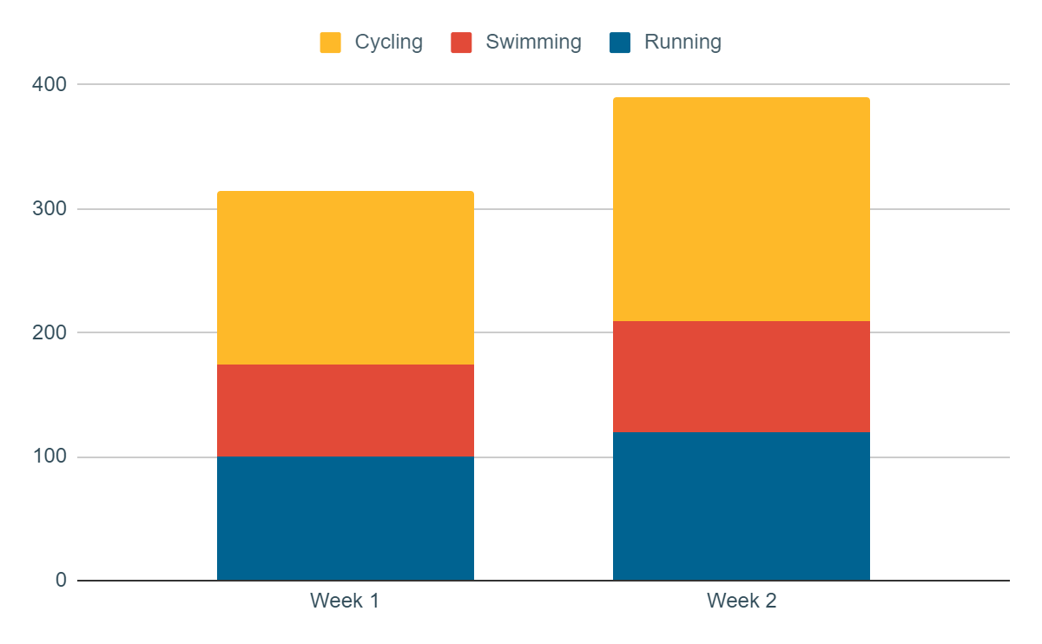
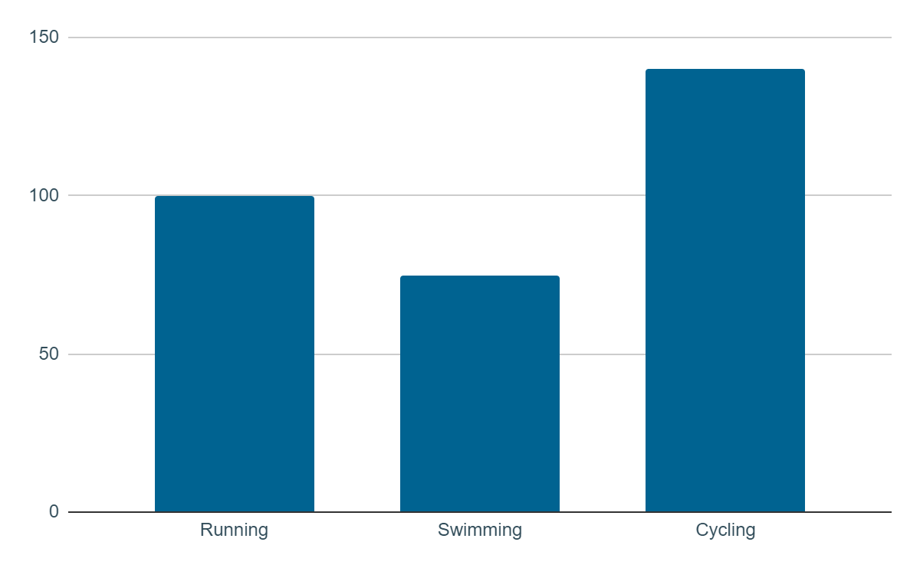
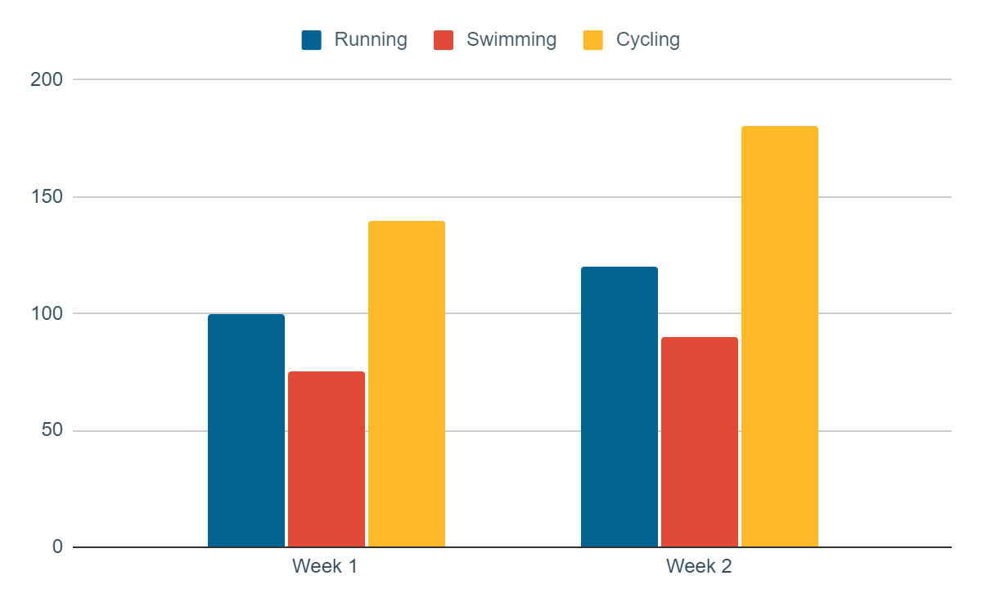
Bar charts
Match the type of bar chart to its example.
standard bar chart
comparison bar chart
stacked bar chart

Slide 33
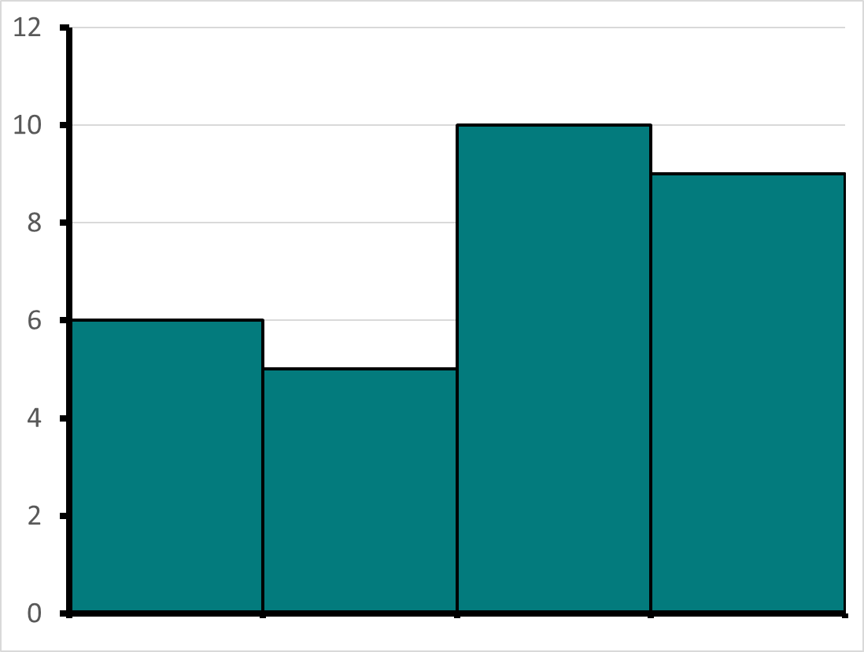
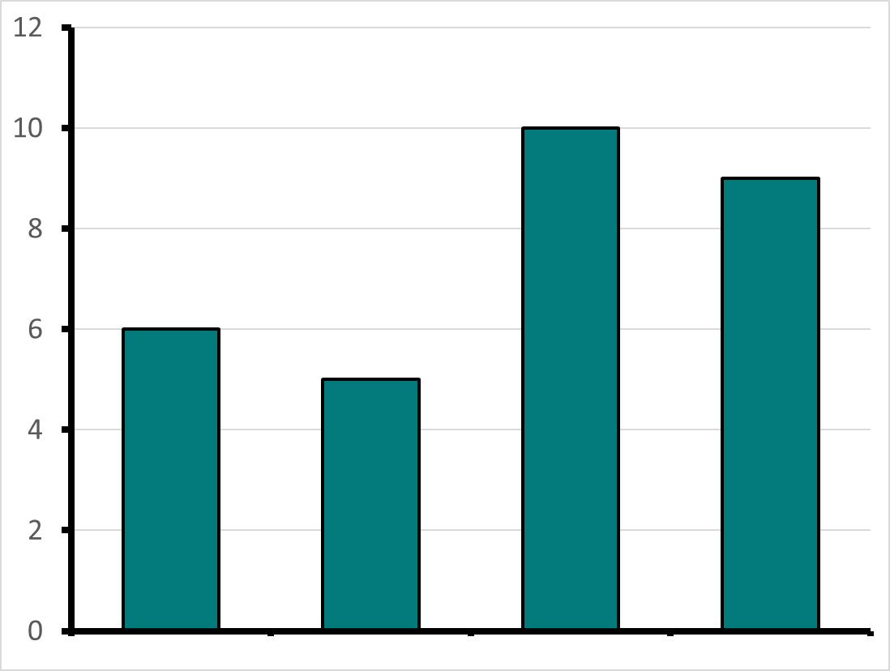

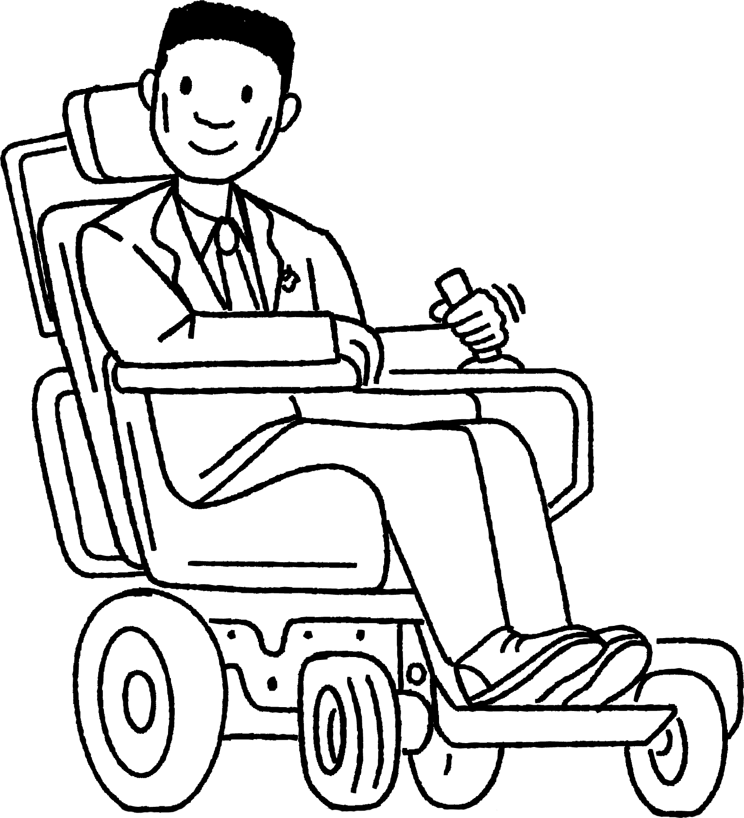
Bar charts
Jacob and Alex have both constructed bar charts for the same data, regarding ice cream sales and the flavour. The flavours are vanilla (V), strawberry (S), chocolate (C) and other (O).
12
12
10
10
Frequency
8
8
6
6
4
4
2
2
0
0
V
S
C
O
V
S
C
O
Ice cream flavours

Slide 34
Bar charts
the heights of the bars
the vertical scale
the order
What is the same?
12
12
10
10
Frequency
8
8
6
6
4
4
2
2
0
0
V
S
C
O
V
S
C
O
Ice cream flavours

Slide 35
Bar charts
axis titles missing from Alex’s
gaps between bars missing from Jacob’s
What mistakes have been made?
12
12
10
Frequency
10
8
8
6
6
4
4
2
2
0
0
V
S
C
O
V
S
C
O
Ice cream flavours

Slide 36
Bar charts
Bar charts should have gaps between each bar.
There is no data between the two categories, they are separate.
It is your choice whether there are gaps or not.

Slide 37
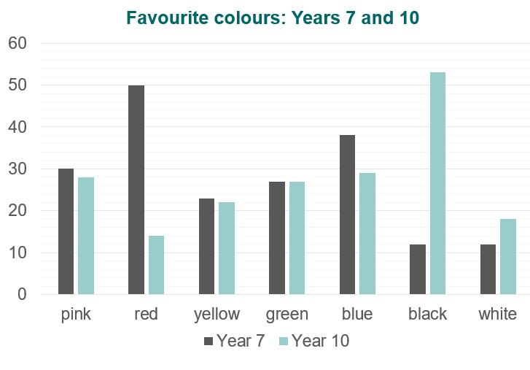
Bar charts
1) Use this bar chart to answer the following questions:
a) Which was the most popular colour in each year?
b) Compare the number of students who liked yellow best in each year group.
c) How many more Year 7 students than year 10 students liked green best?
d) How many students were in each year group?

Slide 38
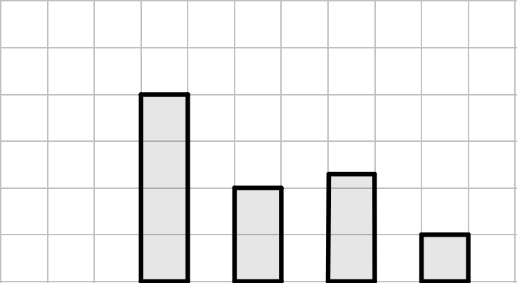
Bar charts
This bar chart shows the different ways that students travel to school. Label the two axes and complete the bar chart based on the clues.
The most popular way to travel is walking.
The least common way to travel is on a scooter.
Twice as many people walk as cycle.
The number of people who travel by car is three-quarters of the number of people who walk.
Twelve people travel by bus.
Car

Slide 39
Bar charts
1) Use this bar chart to answer the following questions:
a) Which was the most popular colour in each year? Year 7: red, Year 10: black
b) Compare the number of students who liked yellow best in each year group. One more student liked yellow in year 7 than year 10.

Slide 40
Bar charts
Which questions can you answer by using the bar chart?
How many more Year 7 students than year 10 students liked green best?
None, it was equal.
How many students were in each year group? Year 7: 192 students Year 10: 191 students

Slide 41
Bar charts
This bar chart shows the different ways that students travel to school. Label the two axes and complete the bar chart based on the clues.
25
Frequency
20
15
10
5
Car
Walk
Cycle
Bus
Scooter
Methods of travel

Slide 42
Checking understanding of pictograms and bar charts
Pictograms and bar charts both represent data through frequency.
Pictograms use icons to show the frequency, where a key is given to support.
Bar charts represent frequency using the height (or length if the chart is horizontal) of a bar. There are gaps between each bar.

Slide 43

© Oak National Academy 2023.
Produced in partnership with Mathematics in Education and Industry.
Licensed on the Open Government Licence v3.0, except where otherwise stated. See Oak terms and conditions.

